Slide 1


CMPE 135: Object-Oriented Analysis and Design November 9 Class Meeting
Department of Computer Engineering San Jose State University Fall 2017 Instructor: Ron Mak
www.cs.sjsu.edu/~mak

Slide 2
Design Patterns so Far!
Strategy
Observer
Decorator
Factory Method
Abstract Factory
Singleton
Adapter
Facade
State

Slide 3
Design Patterns Today
Iterator
Composite
These examples and their images are from
Head First Design Patterns
by Eric & Elizabeth Freeman
O’Reilly, 2004

Slide 4
Different Menu Structures
We want to merge Lou’s Pancake House and Mel’s Diner.
The Pancake House’s breakfast menu is implemented as a Java ArrayList (similar to a C++ STL vector).
The Diner’s lunch menu is implemented as an array.
Fortunately, both agree on the implementation of the menu items.

Slide 5
Menu Item Implementation

Slide 6
Pancake House Menu as an ArrayList

Slide 7
Diner Menu as an Array

Slide 8
The Waitress Program
The waitress program (named Alice) must put together customer orders from both menus.
First, Alice needs to obtain both menus:

Slide 9
The Waitress Program, cont’d
She requires two different ways to loop through the menus.

Slide 10
Different Ways to Iterate
The ways to iterate differ due to the different menu structures.
To iterate through the breakfast items, we use the size() and get() methods on the ArrayList.

Slide 11
Different Ways to Iterate, cont’d
To iterate through the lunch items, we use the array length field and array subscripting.
Can we encapsulate what changes, the different ways to iterate over the menu items?

Slide 12
The Iterator Design Pattern
The Iterator Pattern encapsulates different ways to iterate over the items in a collection.
arrays, lists, hash tables, etc.

Slide 13
An Iterator for the Diner Menu
In C++, an iterator acts like a pointer variable.
An important goal is not to expose the internal implementation of the collection.

Slide 14
An Iterator for the Diner Menu, cont’d
First, the iterator interface:
Then the concrete iterator for the Diner menu ...

Slide 15
An Iterator for the Diner Menu, cont’d

Slide 16
The Diner Menu with an Iterator

Slide 17
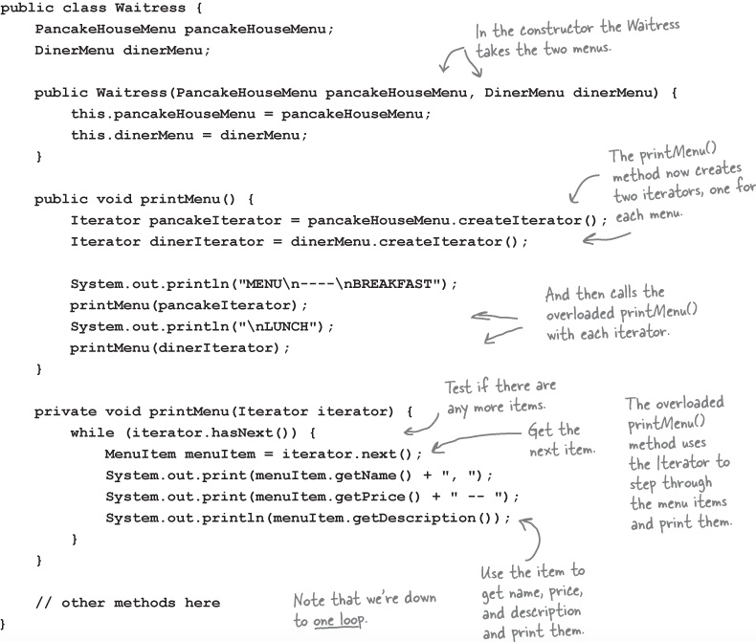
New Code for Alice the Waitress

Slide 18
Waitress Implementations
Hard-to-Maintain Waitress Implementation | New Waitress Powered by Iterator
The menus are not well encapsulated; we can see the Diner is using an ArrayList and the Pancake House an array. | The menu implementations are now encapsulated. The waitress has no idea how the menus hold their collection of menu items.
We need two loops to iterate through the menu items. | All we need is a loop that polymorphically handles any collection of items as long as it implements Iterator.
The Waitress is bound to concrete classes (MenuItem[] and ArrayList). | The Waitress now uses an interface (Iterator).
The waitress is bound to two different concrete menu classes, despite their interfaces being almost identical. | The menu interfaces are now exactly the same, but we still don’t have a common interface, which means the waitress is still bound to two concrete menu classes.

Slide 19
Our Design So Far

Slide 20
Common Interfaces
C++ equivalent:
vector<MenuItem *>::iterator create_iterator()
{
return new vector<MenuItem *>::iterator();
}

Slide 21
Common Interfaces, cont’d
A common interface for the menus.
Allow clients to create an iterator for the menu items.

Slide 22
Common Interfaces, cont’d

Slide 23
Updated Design

Slide 24
Iterator Design Pattern Defined
The Iterator Design Pattern provides a way to access the elements of a collection sequentially without exposing the collection’s underlying representation.

Slide 25
Iterator Pattern Class Diagram

Slide 26
Printing Menus
The waitress’s printMenu() function has duplicated code:

Slide 27
An ArrayList of Menus?

Slide 28
Change: Add a Dessert Menu

Slide 29
What we Need
We need some kind of a tree-shaped structure that will accommodate menus, submenus, and menu items.
We need to make sure we maintain a way to traverse the items in each menu that is at least as convenient as what we are doing now with iterators.
We may need to traverse the items in a more flexible manner. For instance, we might need to iterate over only the Diner’s dessert menu, or we might need to iterate over the Diner’s entire menu, including the dessert submenu.

Slide 30
What we Need, cont’d

Slide 31
The Composite Design Pattern Defined
The Composite Design Pattern allows you to compose objects into tree structures to represent part-whole hierarchies.
Composite lets clients treat individual objects and compositions of objects uniformly.

Slide 32
The Composite Design Pattern, cont’d
We can create arbitrarily complex trees:

Slide 33
The Composite Design Pattern, cont’d

Slide 34
The Composite Design Pattern, cont’d
Apply operations to the whole tree:
Or to the parts.

Slide 35
Composite Pattern Class Diagram

Slide 36
Design Menus with the Composite Pattern

Slide 37
Menu Component Abstract Class

Slide 38
Menu Item Implementation

Slide 39
Composite Menu Implementation

Slide 40
Printing Menus and Menu Items
A menu is a composite.
Contains menu items.
Contains other menus
Example: A dessert submenu.
The print() method should print everything that the menu contains.

Slide 41
Printing Menus and Menu Items, cont’d

Slide 42
Update the Waitress Code

Slide 43
Test Run
Every Menu and
MenuItem implements the
MenuComponent interface.

Slide 46
A Composite Iterator
Allow the waitress to iterate over an entire composite of menus.

Slide 47
A Composite Iterator, cont’d
Update the Menu and MenuItem classes.

Slide 48
A Composite Iterator, cont’d
The iterator returns the next menu component, which is either a menu item or a submenu.
Whenever the iterator encounters a submenu, it pushes the submenu onto a stack.
Use the stack to maintain the iterator’s position as it moves up and down the composite tree.

Slide 49
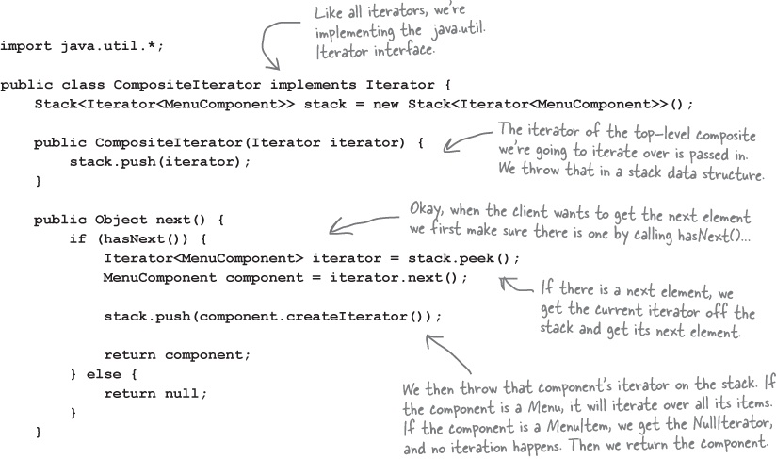
A Composite Iterator, cont’d

Slide 50
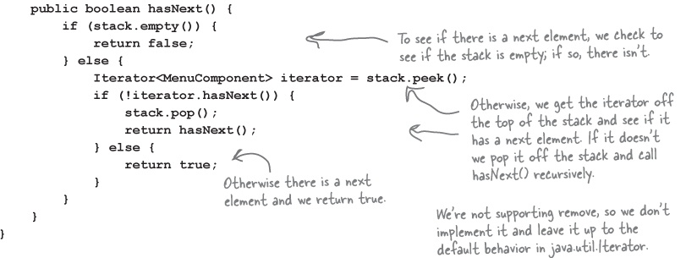
A Composite Iterator, cont’d

Slide 51
The Null Iterator
A MenuItem object has nothing to iterate over.
Its createIterator() method can either:
Return null. Conditional code needed to test for null.
Return an iterator whose hasNext() always returns false. No special conditional code needed.

Slide 52
The Null Iterator, cont’d

Slide 53
Composite Iterator Test Run: Vegetarian

